Slide 1
ReviewSense: E-commerce Product Review Categorization using Transformer Embeddings

Slide 2
Abstract
"ReviewSense" is an innovative project in the field of Natural Language Processing (NLP), targeting the analysis and categorization of e-commerce product reviews. Utilizing advanced transformer models like BERT and DistilBert, this project aims to revolutionize the way online product reviews are processed and understood. The focus lies in sentiment analysis and aspect-based categorization, enhancing the depth and accuracy of interpreting customer feedback. The research underscores the need for advanced NLP techniques in tackling the complexities and nuances of consumer language in online reviews.

Slide 3
Introduction
Project Overview
"ReviewSense" focuses on improving sentiment analysis in the e-commerce sector by leveraging the latest advancements in NLP. The project is designed to analyze online product reviews by categorizing them into specific sentiments and identifying various aspects mentioned in the reviews.
Role of Sentiment Analysis in E-commerce
Sentiment analysis in e-commerce is vital for translating customer reviews into insightful data. These insights guide businesses in decision-making and improving customer engagement. Accurately analyzing sentiments in product reviews directly influences consumer purchasing decisions and overall brand reputation.
Relevance of NLP and Transformer Models
In sentiment analysis, the use of NLP and specifically transformer models like BERT and DistilBert is revolutionary. These models excel in deciphering the nuances and context of language, offering a more sophisticated approach to understanding customer feedback than traditional models.

Slide 4
Objectives and Goals
Enhancing Sentiment Analysis
A key objective is to advance sentiment analysis techniques in e-commerce. This includes accurately categorizing online reviews into different sentiments and dissecting the reviews to understand the various aspects of products being discussed.
Utilization of Advanced NLP Models
The project underlines the importance of using advanced NLP models. These models are expected to offer superior performance in analyzing customer reviews, owing to their ability to comprehend complex language patterns and context.
Project Outcomes
Expected outcomes include improved accuracy in sentiment analysis, deeper understanding of customer reviews, and the generation of actionable insights for businesses. These outcomes are anticipated to contribute significantly to enhancing the effectiveness of sentiment analysis in e-commerce.

Slide 5
Problem Statement
Analyzing E-commerce Product Reviews
E-commerce platforms generate a large volume of product reviews that are often complex in nature. These reviews contain a mix of sentiments and linguistic nuances, making them challenging to analyze effectively with traditional methods.
Limitations of Traditional Techniques
Current sentiment analysis techniques often lack the sophistication needed to interpret the complex language used in online reviews. These methods tend to oversimplify sentiments, leading to inaccurate interpretations.
Need for Advanced Analytical Solutions
There is a clear need for advanced solutions in sentiment analysis. Transformer models like BERT and DistilBert are proposed as they offer promising capabilities in understanding and accurately interpreting the intricate aspects of natural language used in customer reviews.

Slide 6
Literature Review
Summary of Key Findings
Recent scholarly works reveal an intriguing evolution in sentiment analysis, showcasing the journey from rudimentary text processing to the application of sophisticated AI and ML techniques. This progression is marked by a shift from purely statistical methods to more complex models capable of nuanced language interpretation.
Evolution of Sentiment Analysis in NLP
Initially, sentiment analysis relied heavily on simple linguistic rules and basic statistical approaches. The field gradually embraced more refined statistical NLP, utilizing algorithms like Naive Bayes and Support Vector Machines. The real transformation, however, occurred with the introduction of machine learning and, subsequently, deep learning techniques, which enabled models to capture more intricate language patterns.
Previous Work Using AI and ML in Sentiment Analysis
The incorporation of AI and ML in sentiment analysis marked a significant milestone. It introduced capabilities like semantic analysis and contextual understanding, far beyond the scope of traditional methods. Pioneering works have demonstrated the effectiveness of deep learning models, particularly neural networks, in elevating the accuracy and depth of sentiment analysis.

Slide 7
Methodology Overview
Approach and Methodology
The project adopts a multifaceted approach, integrating advanced NLP models for an in-depth analysis of e-commerce product reviews. This methodology aims to surpass traditional sentiment analysis techniques by leveraging transformer models capable of intricate language and context processing.
Tools and Libraries Used
Key technologies and libraries underpinning this project include Python for its extensive data analysis and machine learning capabilities. Libraries such as Pandas and NumPy facilitate data manipulation, while TensorFlow and PyTorch provide the infrastructure for deep learning tasks. Central to the project is the Transformers library, which offers access to pre-trained models like BERT and DistilBert.
High-Level View of System Architecture
The architecture is constructed to be robust and scalable, comprising layers dedicated to data ingestion, preprocessing, machine learning, system integration, and user interaction. This setup ensures efficient data handling, analysis, and visualization, accommodating the project's comprehensive analytical demands.

Slide 8
Data Acquisition and Preprocessing
Sources of Data
The primary dataset for this study is sourced from the Amazon Product Review collection available on Kaggle. This extensive dataset provides a diverse range of product reviews, forming the foundation for the project's sentiment analysis.
Data Preprocessing Steps
The preprocessing of the dataset includes:
Text Cleaning: Standardizing text by converting to lowercase, removing noise like special characters, and handling URLs.
Label Encoding: Transforming sentiment labels into a numerical format to facilitate machine learning processing.
Data Splitting: Dividing the dataset into training and testing sets, ensuring a balanced representation across various sentiment categories for effective model training and validation.

Slide 9
Model Development
Introduction to BERT and DistilBERT Models
BERT (Bidirectional Encoder Representations from Transformers) and its streamlined counterpart, DistilBERT, are at the forefront of transformer models in NLP. These models have revolutionized the understanding of context and nuances in textual data. They function by analyzing text sequences in a bidirectional manner, enabling a deeper grasp of language semantics.
Implementation Details
The implementation phase involved integrating BERT and DistilBERT into the sentiment analysis pipeline. This process included fine-tuning these pre-trained models with the Amazon Product Review dataset to adapt them to the specific nuances of consumer reviews in e-commerce.
Overview of Model Training and Analysis
Model training entailed feeding the processed review data into these models and iteratively adjusting parameters for optimal performance. The analysis focused on how these models interpreted various aspects of the reviews, from general sentiment tones to specific attributes like product quality and customer service.

Slide 10
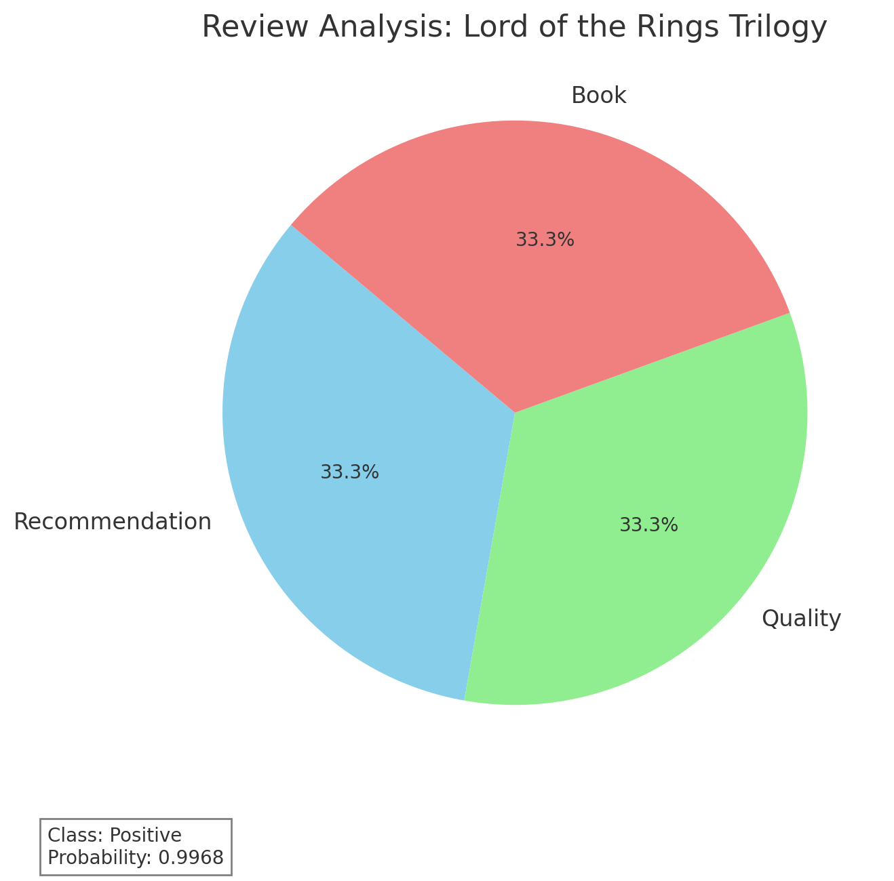
Sample Output
An absolutely FANTASTIC story!!: I'm reading this trilogy for the third time, and I absolutely LOVE IT!! If it gets better than this, I don't want to know about it! If you don't know much about Lord of The Rings or the world of Tolkien in general, you need to start with "The Hobbit". There you will learn the story of Hobbits and how the One Ring came into their possession. This particular review is for an illustrated version that is all three books in one. The art is great, but including the Appendix (A-F) and the Index, this book has over 1193 pages. At times you feel as though you're getting nowhere. I personally recommend a three book set. But which ever one you choose, you'll love it.

Slide 11
Challenges and Solutions
Challenges Faced During the Project
Throughout the project, several challenges were encountered, including:
Handling Large Datasets: The sheer volume of review data posed a challenge in terms of processing and analysis.
Model Fine-Tuning: Adjusting the models to accurately interpret the nuances in consumer reviews required extensive experimentation.
Computational Limitations: The resource-intensive nature of BERT and DistilBERT necessitated considerable computational power.
Solutions and Workarounds Implemented
Effective strategies were deployed to overcome these challenges:
Data Management Techniques: Efficient data preprocessing and batch processing methods were implemented to manage large datasets.
Hyperparameter Optimization: Systematic experimentation with different hyperparameters helped in fine-tuning the models for better accuracy and performance.
Resource Allocation: Utilizing cloud computing resources and optimizing the computational framework ensured smooth processing and analysis despite the high resource demands of the models.

Slide 12
Key Findings and Discussion
The "ReviewSense" project revealed several crucial insights:
Enhanced Accuracy and Contextual Understanding: Transformer models, particularly BERT and DistilBERT, demonstrated a significant improvement in the accuracy of sentiment analysis compared to baseline models. These models effectively understood and interpreted the context and nuances within customer reviews.
Aspect-Based Analysis: The project successfully implemented aspect-based sentiment analysis, offering detailed insights into specific elements of products, like quality and customer service, that traditional methods often overlook.
Implications in E-commerce
These findings have profound implications for e-commerce:
Data-Driven Decision Making: The ability to accurately analyze customer sentiment enables businesses to make more informed decisions about product development and marketing strategies.
Enhanced Customer Understanding: Businesses can gain a deeper understanding of customer needs and preferences, facilitating personalized customer experiences and improved satisfaction.

Slide 13
Future Work and Recommendations
Potential Future Enhancements
Multilingual and Cross-Cultural Analysis: Extending the model to understand and analyze reviews in multiple languages and cultural contexts.
Real-Time Analysis and Integration: Developing the capability for real-time sentiment analysis and integration with e-commerce platforms for dynamic feedback.
Exploring Additional Data Types: Incorporating multimodal data such as images and videos for a more comprehensive sentiment analysis.
Recommendations
For businesses and academia:
Adoption in Customer Relationship Management: Businesses should integrate these advanced NLP techniques into their CRM systems for deeper customer insights.
Academic Research and Development: Academia should focus on further refining transformer models and exploring their applications in diverse fields beyond e-commerce.

Slide 14
Conclusion
The "ReviewSense" project marks a significant advancement in the application of NLP for e-commerce sentiment analysis. By successfully implementing and validating the efficacy of transformer models like BERT and DistilBERT, the project demonstrates a leap forward from traditional sentiment analysis methods. These advanced models have shown a remarkable ability to understand the intricacies of natural language, providing more accurate and nuanced insights into customer reviews. The implications of these findings are vast, offering e-commerce businesses a powerful tool to understand and respond to customer feedback more effectively. This research not only contributes to the domain of NLP but also opens avenues for further innovations and applications in various sectors. The "ReviewSense" project, with its breakthroughs and potential for future enhancements, stands as a testament to the transformative power of AI and machine learning in understanding human sentiment and behavior.

